Slide 1
Survey Summary
,,Smoking is passe”

Slide 2
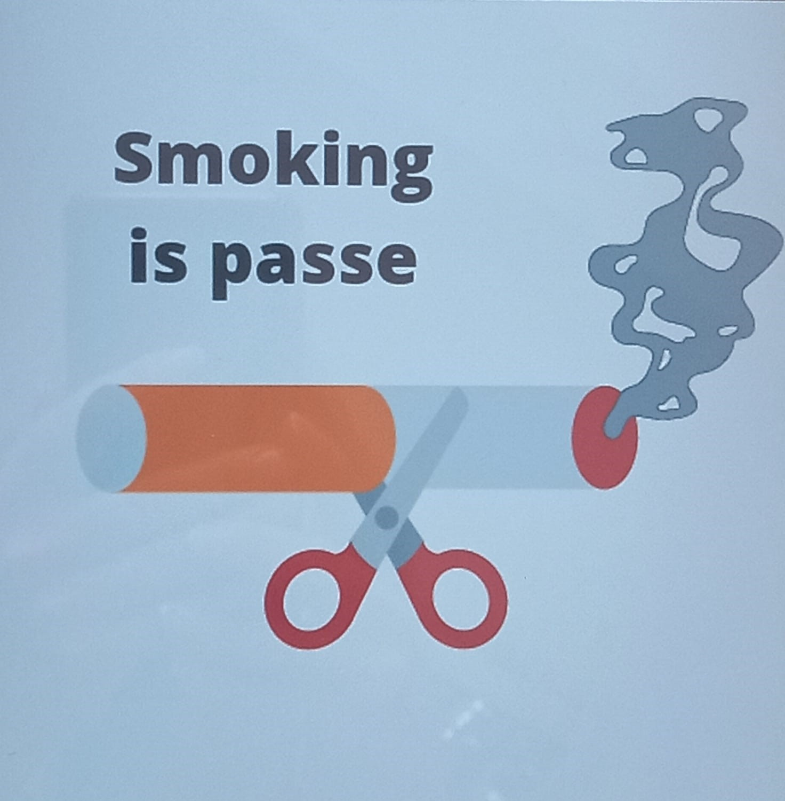
05.04.2022
International Youth Mobility

Slide 3
1. Do you smoke ?
56% of the respondents said that they smoked

Slide 4
2. How old were you when you start smoking?
Aroung 10,9% start smoking
before the age of 12. Most people
start smoking between the ages
of 12 to 18 (about 63,6%). 27,8%
of people start smoking between
19 to 25. Only 3,6% of responses
start smoking after the age of 25.
CONCLUSION
74,5% of people started smoking
before the age of 18.

Slide 5
3. What made you start smoking?
35% of the respondents answered this question
25% of the respondents answered that friends had been the
reason why they started smoking
14% of people answered that curiosity had been the reason
For 3% of the respondents boredom had been the reason
Also 3% of the respondents said that they had wanted to try,
and 3% said that the reason was stupidity
1% said that they tried to smoke because of the problems
and 1% answered they had no reason
CONCLUSION
25% of the respondents answered that friends had been the
reason why they started smoking

Slide 6
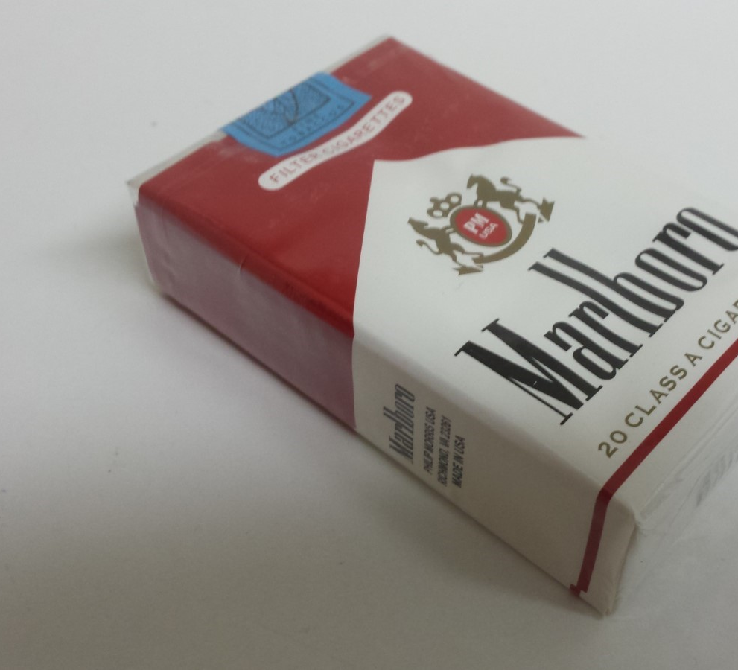
4. How many cigarettes do you smoke a day?
Most people smoke less than 10
cigarettes daily (40,7%).
16,7% of respondents smoke between
11 to 19 cigarettes a day and 35,2% of
people smoke more than 1 pack (20
cigarettes). 7,4% quit smoking
CONCLUSION
People who smoke 2 packs a day spend
around 1,400 RON a month.

Slide 7
5. What do you feel after you smoke?
25% of the respondents answered
42% of the respondents answered this question that they had felt
nothing after smoking
20% answered that they had felt relaxed after smoking.
16% of people had felt good and 12% had felt bad
4% said that they had felt tired, anxious, disgusted, satisfied, dizzy
and that they had wanted to try.
CONCLUSION
42% of the respondents answered that they had felt nothing after
smoking

Slide 8
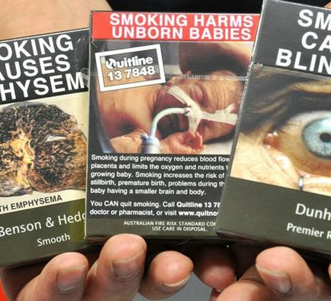
6. Do you think that health warnings on cigarettes are a good idea?
38 people (67,9%) from 56 respondents
think that health warnings on the packs
of cigarettes are good ideas and 18
people (32,11%) thinks otherwise.
CONCLUSION
70% of the respondents think that health
warnings on cigarettes packs are good
idea.

Slide 9
7. What could make you stop smoking?
33 people out of 56 respondents answered this question ( it
means 59%)
21% of the respondents said that the health had been the reason
2 of 33 people (6%) responses that nothing can make them stop
smoking, ambition and bad thing.
Others 25% responses that age, rising gas, prices, sports, stress,
warnings on the cigarettes.
67% people also responses that ambition, health problems, lack
of money, strong will were the reasons or they just don’t know
what could make them stop smoking
CONCLUSION
About 70% of people think that ambition and problems with
health could make them stop smoking.

Slide 10
RECOMMENDATIONS
From the early ages children should be taught thet cigarettes are bad.
We should teach teenagers to be more assertive.
People should stop smoking to save money.
Smoking doesn’t bring any benefit so people should stop smoking.
We should give more warnings on cigarettes packages and advertise abou its bad influence on health.
We shoul increase awarness of young people about how smokiing is ruining their health and what illnesses it causes.

