Slide 1
Fratii Popeea School Sacele, Brasov Smoking – Drivers, effects, and statistics for Romania April 2022

Slide 2
Agenda
History of tobacco and smoking
History of tobacco in Romania
Smoking – drivers and myths
Chemical compounds in a cigarette
Health risks and potential diseases
Effects of smoking
Heart attack and stroke
Coronary artery disease (CAD)
Smoking and pregnancy
Smoking and nutrition
Passive smoking
Health benefits of quitting
Dependency
Nicotine
Quitting
Electronic cigarette
Description and types of e-cigarettes
Pros, cons and dangers of vaping
Statistics for Romania - GATS
Did you know?

Slide 3
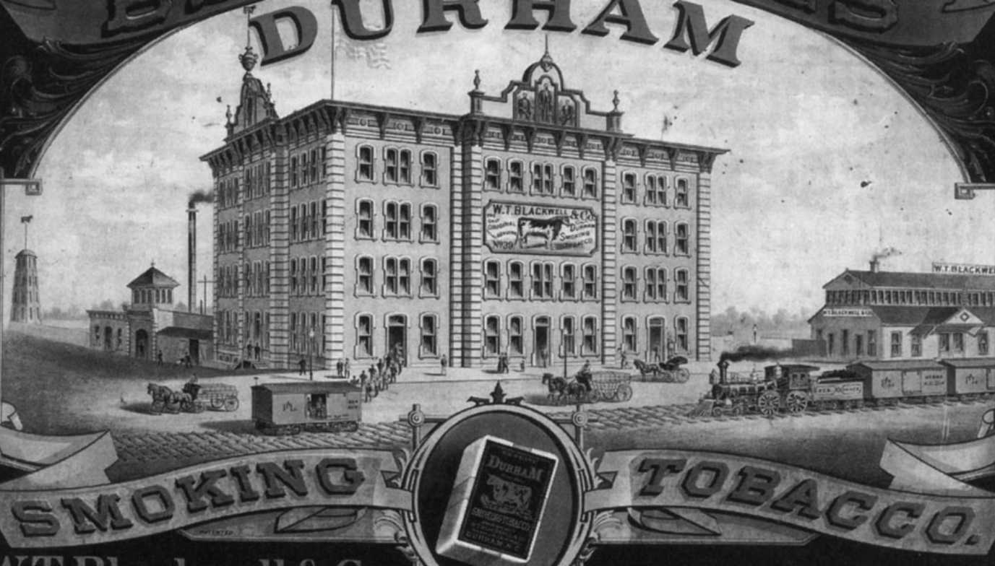
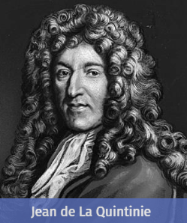
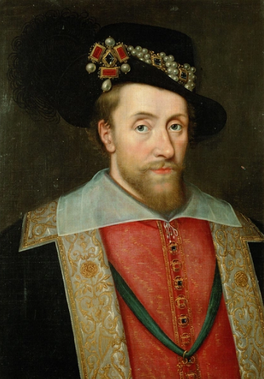
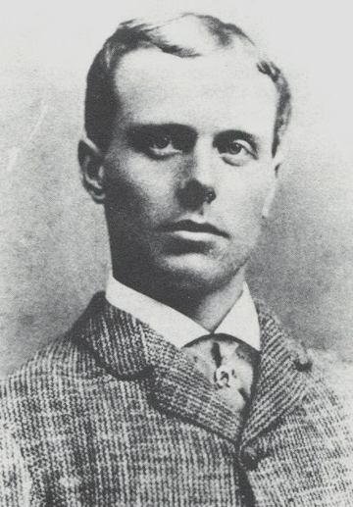
History of tobacco and smoking
Here is a brief global history of tobacco and smoking. Tabaco was first discovered in America approximately 8.000 years ago.
1559
Jean Nicot de Villemain (the French ambassador in Portugal) sends 1.500 tobacco leaves to Francis II and Caterina de Medici for treating their migraines.
Late 16th century
Tobacco first arrived in the Ottoman Empire in the late 16th century where it became prescribed medicine for many ailments.
17th century
James I of England (1566 – 1625) published the first anti-smoking manifesto.
1690
Agronomist Jean de la Quintinie discovers the anti-insecticide properties of tobacco.
1832
Turkish and Egyptian gunners twist tobacco leaves in a thin paper sheet – this is the precursor of modern-day cigarette.
1864
First cigarette factory is opened in the USA with a yearly production of 20 million cigarettes.
1881
James Bonsack invents the cigarette rolling machine which produces 120.000 pieces daily.

Slide 4
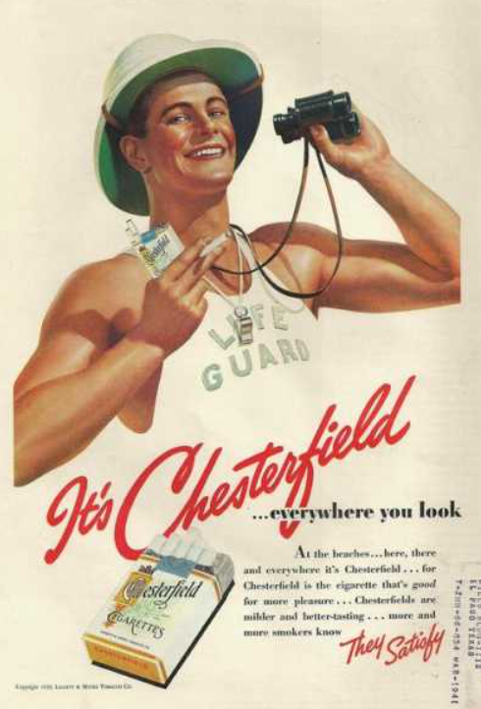
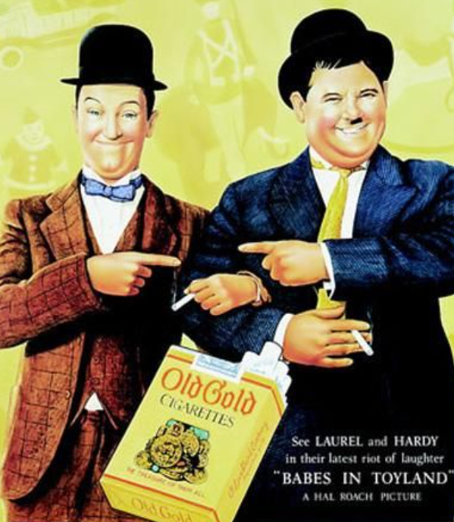
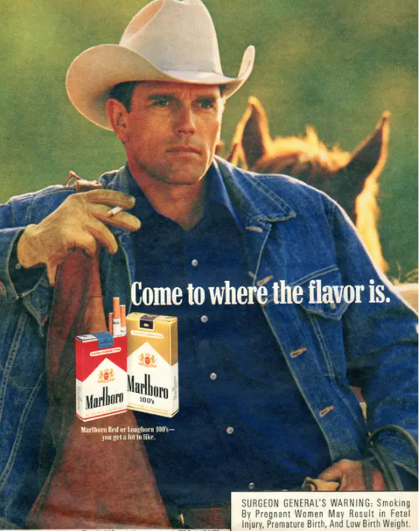
History of tobacco and smoking
Here is a brief global history of tobacco and smoking. Tabaco was first discovered in America approximately 8.000 years ago.
1910
The cigarette industry developped thremendously in Europe, with 20.000 apparent cigarette brands.
1930
Camel emerges as the is the first modern-day cigarette.
1917
The cigarette market is dominated by Camel, Chesterfield and Lucky Strike.
1910 - 1930
The marketing of tobacco expands.
1940 - 1950
The tobacco industry is flourishing, and a lot of celebrities promote smoking, indorsing different cigarette brands. The first negative news about tobacco arise in this period.
1950
Filter cigarettes are invented by Viceroy and Parliament. At the same time, the first scientific studies associating smoking with cancer are published.
1963
The famous Marlboro cowboy is born.

Slide 5
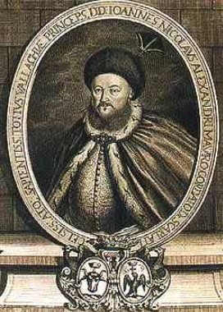
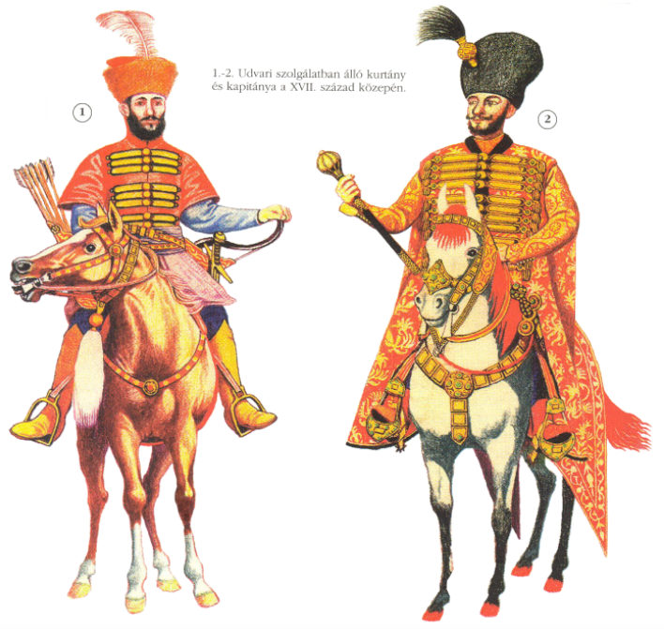
History of tobacco in Romania
An overview of smoking and tobocco in Romania is highlighted below.
1606 – 1610
Tobacco was first introduced by the Turks in Wallachia, by the Austrians in Transylvania and by the Cossacks in Moldavia.
1698
The first evidence of taxation is witnessed when Constantin Duca (ruler of Moldavia) perceives a tax of 4 lei / parcel for a tobacco plantations.
17th - 18th century
Nicolae Mavrocordat – ruler of Wallachia with a PhD in Medicine wrote a leaflet warning about the negative effects of smoking.
The oldest evidence of smoking was discovered in the 17th Century at the ruins of Suceava citadel.
1606 – 1610
In Transylvania a document related to the history of Saxons reveals that tobacco was widely smoked by all social classes, so the rulers levied a fine on smokers .
1967

Slide 6
Smoking – drivers and myths
Let’s analyze below some of the reasons that drive people to some as well as a couple pf misconceptions about smoking.
Drivers
Myths
Some of the reasons that drive people to smoke are highlighted below:
The misconceptions that people have related to smoking are:
Shaping a social image and fitting in
Tobacco is not extremely harmful, it is not a drug and smoking is legal
Low self esteem
Smoking is helping people be fit and not gain weights
Releasing pressure and finding temporary stress relief
Smoking makes people feel more attractive
Seeking a good, fun time and improving the mood
Smoking relaxes people and makes them feel good
Boredom
Smoking allows you to meet and connect with people
Absence of believable role models
Smoking is a habit that can hardly be overcome
Commercials and marketing products promoting smoking

Slide 7
Chemical compounds in a cigarette
Several different chemical components are present in the cigarette and the cigarette smoke and many of these have a great impact on our health.
Carbon monoxide
Gas from car exhausts
Some of the substances encountered in cigarette smoke are mentioned below:
Paint
7357
increases heart rate, blood pressure and glucose
creates dependency
Hexamine
Barbecue lighter
Nicotine
Pesticides, insecticide
Nicotine
Estimated number of chemical compounds in cigarette smoke
N-Nitrosamines
known human carcinogen
Stearic acid
Candle wax
Tar
Road surfaces
known human carcinogen
damages bone marrow and lowers red blood cell count
70
Benzene
Acetone
Nail Varnish Remover
Ammonia
Cleaning products
Number of chemical compounds with confirmed carcinogenic activity
Aromatic amines
known human carcinogen
linked with bladder cancer
Arsenic
Rat poison
Methanol
Rocket fuel
known animal carcinogen
probable human carcinogen
250
Acetaldehyde
Hydrogen Cyanide
Poison used on death row
Formaldehyde
Embalming fluid
1,3 - Butadiene
known animal carcinogen
probable human teratogen
At least 250 chemicals are known to be toxic
possible human carcinogen
known DNA mutagen
Cadmium
Batteries
Acrolein
Radon
Radioactive gas
Butane
Lighter fluid
Polyaromatics
known human carcinogen
known DNA mutagen

Slide 8
Disclaimer
Some of the images that will follow may be disturbing to some readers.

Slide 9
Health risks and potential diseases
Smoking poses significant health threats and below we have a representation of all the areas in the human body which are affected by smoking.
Heart attack, stroke and other cardiovascular diseases
Dementia
Reduced fertility in men and women
Oral cancer and other oral diseases
Erectile dysfunction
Throat cancer
Menstruation and menopause
Other cancers
Lung cancer
Vision loss
Asthma
Hearing loss
Chronic obstructive pulmonary disease
Gastronintestinal disease
Tuberculosis
Weakend immune system
Other respiratory illness and reduced lung function
Weak bones
Type 2 diabetes
Skin damange

Slide 10
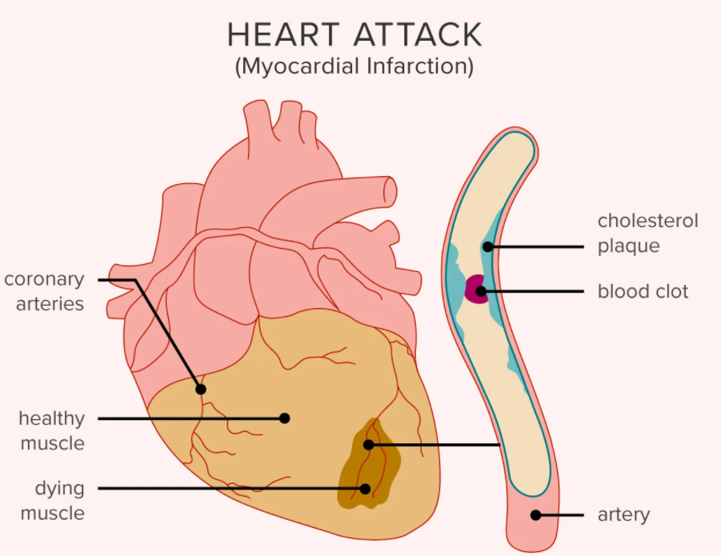
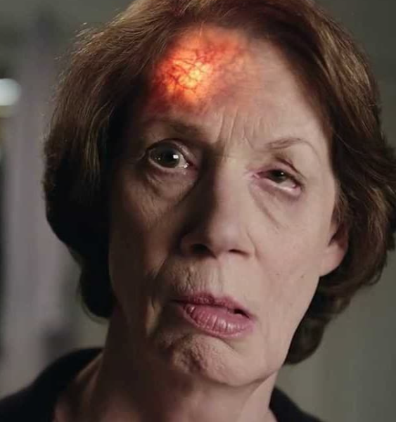
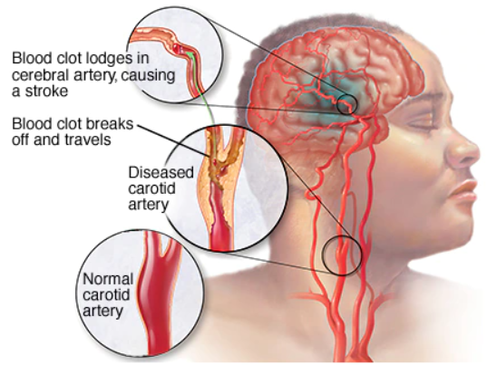
Heart attack and stroke
Besides cancers, heart attack and stroke are two of the major health issues cause by smoking and their risks can be mitigated by quitting.
Benefits of quitting
People who quit smoking before age 50 reduce their risk of dying by half in the next 15 years compared with continuing smokers.
Quitting before age 35, can almost reverse all risks of smoking.
If you already have coronary artery disease, your risk of a second heart attack and possible sudden death decreases when you quit smoking.
Heart attack and stroke
Risks
A smoker’s chance of dying from a heart attack is 2-3 times greater than that of a non-smoker.
About 1 in 4 heart attacks is believed to be directly related to smoking.
When a smoker who has a heart attack, their risk of sudden death is twice that of a non-smoker.
Smoking is a much higher risk factor for a heart attack or stroke than high cholesterol, obesity, high blood pressure, or stress.

Slide 11
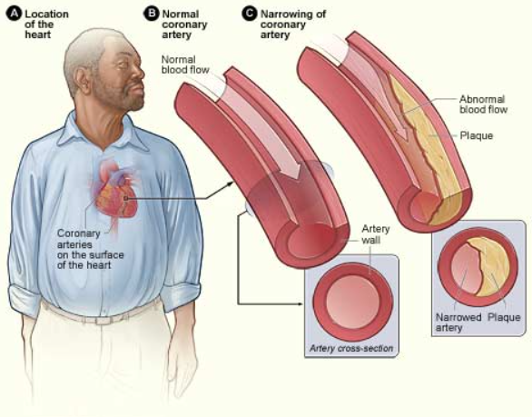
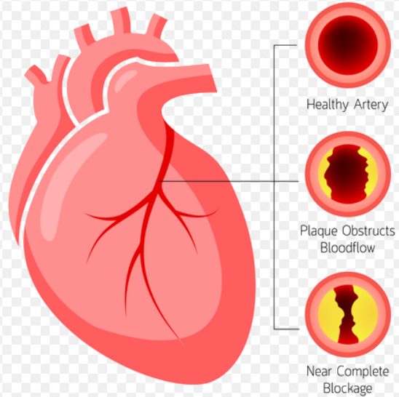
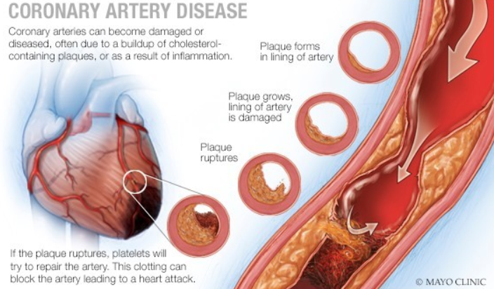
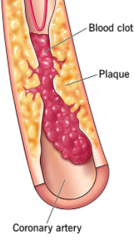
Coronary arthery disease (CAD)
Coronary artery disease is one of the major causes of death worldwide and smoking increases the likelihood of developing CAD.
Benefits of quitting
After your first year of not smoking, your risk of heart disease decreases by half. Also, your risk of having a heart attack decreases when you stop smoking.
After 15 years since quitting, your risk of death from heart disease is the same as if you had never smoked at all.
Coronary artery disease (CAD)
Risks
Smoking causes blood platelets to clump with a high risk to form clots.
Can cause spams in coronary arteries which can reduce blood flow to the heart.
Smoking cause irregular heartbeats.
Lowers HDL or “good cholesterol”.
Reduces oxygen in red blood cells.

Slide 12
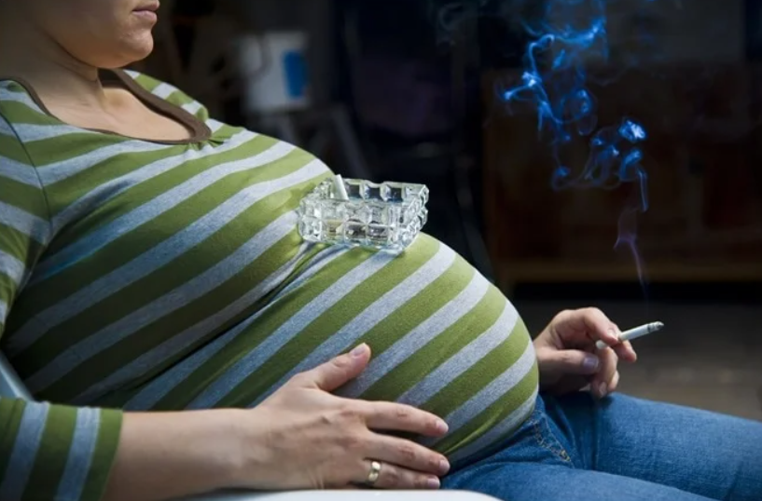
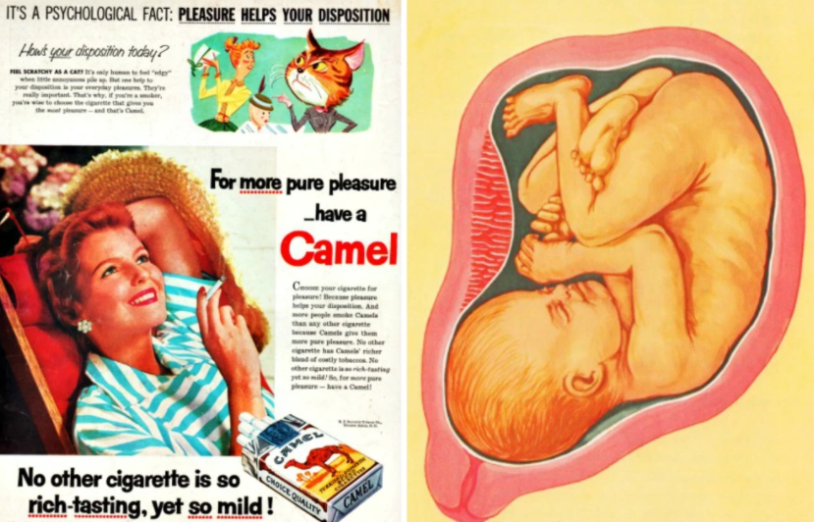
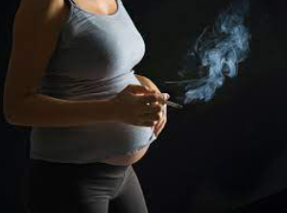
Smoking and pregnancy
Smoking can negatively impact pregnancy and in some cases can lead to miscarriages and stillbirths.
Benefits of quitting
If you quit smoking before you become pregnant (or sometime during the first 3 months of your pregnancy), your risk of having a baby with low birth weight is the same as that of a woman who does not smoke.
Women who quit later in their pregnancy still reduce the risk of problems for their babies.
Pregnancy
Risks
Women who smoke are more likely to have the following problems:
Stillbirths and miscarriages
Low birth weight
Children who have learning, emotional, and behavioral problems

Slide 13
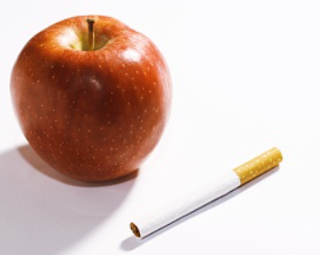
Smoking and nutrition
Some of the main diseases caused by smoking are described below from the point of view of risks and benefits of quitting.
Benefits of quitting
The body will be able to absorb essential vitamins and minerals creating a strong immune system.
A stronger immune system improves the body’s ability to repair and strengthen itself.
High antioxidant levels creates stronger bones, reduces the likeliness of getting sick, and allows the body to health properly.
Nutrition
Risks
Smoking drains the body of essential vitamins and minerals and blocks absorption of these vital nutrients including antioxidants.
Smoking accelerates to production of free radicals. Free radicals may cause tissue and organ damage. Low antioxidant levels reduces the body’s ability to fight off these free radicals.
Vitamin D, which aids in calcium absorption, is affected by smoking. Smokers are at higher risk for osteoporosis.

Slide 14
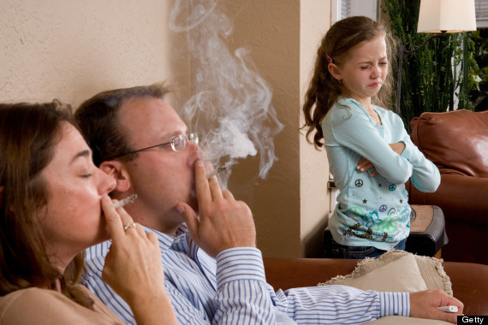
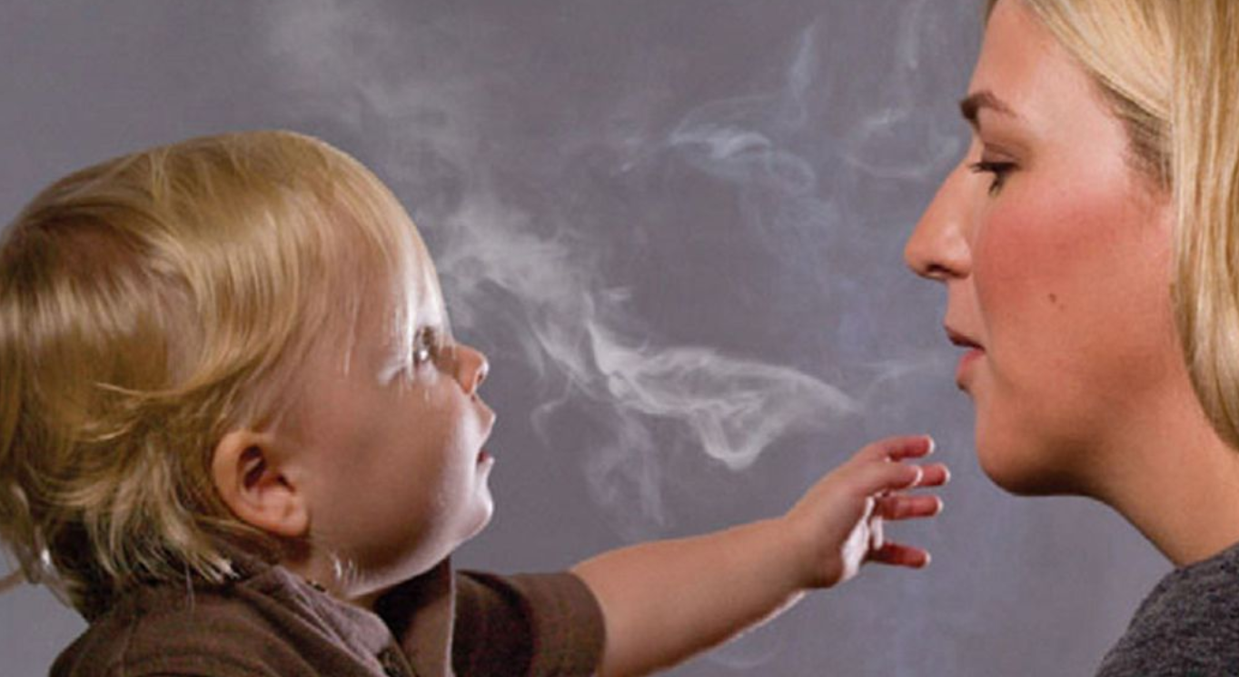
Passive smoking
Smoking impacts more than just the smoker. Family members, colleagues, and friends are impacted through what is known as the “secondhand smoke”.
Benefits of quitting
When you quit smoking, you reduce the risks for health problems in your family.
You also increase the chance that your children will not smoke or will quit if they already smoke.
Passive smoking
Risks
Second-hand smoke allegedly kills 600,000 people a year.*
Children are more heavily exposed to second-hand smoke than any other age group, and around 165,000 of them a year die because of it.*
Spouses and children have an increased risk of cancer and heart disease. Babies whose parents smoke:
Are more likely to have ear infections, pneumonia, and bronchitis in the first years of their lives
Have a higher risk of Sudden Infant Death Syndrome (SIDS)
*According to a study done by the World Health Organization in 2010

Slide 15
Health benefits of quitting
The health benefits of quitting are quite significant and can be noticed from the first hours of stopping. Quitting can have long lasting, positive effects on a person’s health and the timeline below will clearly show that it is never too late to quit!
The cardiac frequency and periferic circulation are is improved
Nicotine is fully eliminated and the smoker recovers their sense of taste and smell
Breathing is improved
Coughing and wheezing is reduced
Risk of heart disease reduced to half that of a smoker
20min
8h
24h
48h
72h
2 – 12 weeks
3-9 months
1 year
10 years
15 years
Nicotine and carbon monoxide levels in blood are reduced by more than 50%
Risk of heart attack falls to the same level as someone who has never smoked
Lungs start to clear out smoking debris
Risk of heart disease reduces by about 50%
Circulation improves

Slide 16
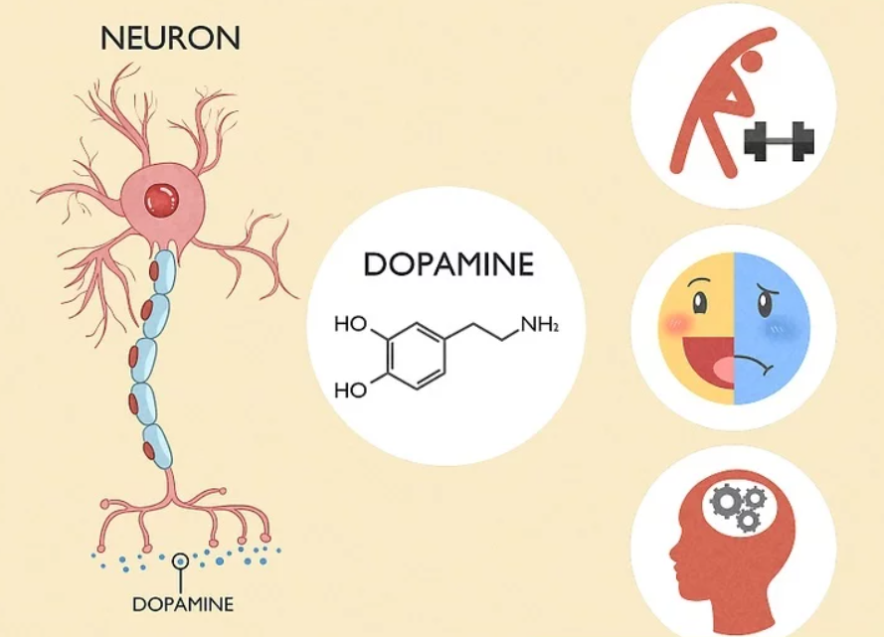
Dependency
Why is it so difficult to quit smoking? The answer is in the brain: “the need” comes from chemical cerebral processes.
DEPENDENCY CYCLE
When one smokes, the nicotine reaches the brain within seconds
The nicotine causes a series of biochemical reactions that lead to higher levels of dopamine
Between smoking the level of dopamine starts getting down and smokers start feeling nervous, anxious, irritated and agitated
Dopamine is a substance associated with calm, pleasure

Slide 17
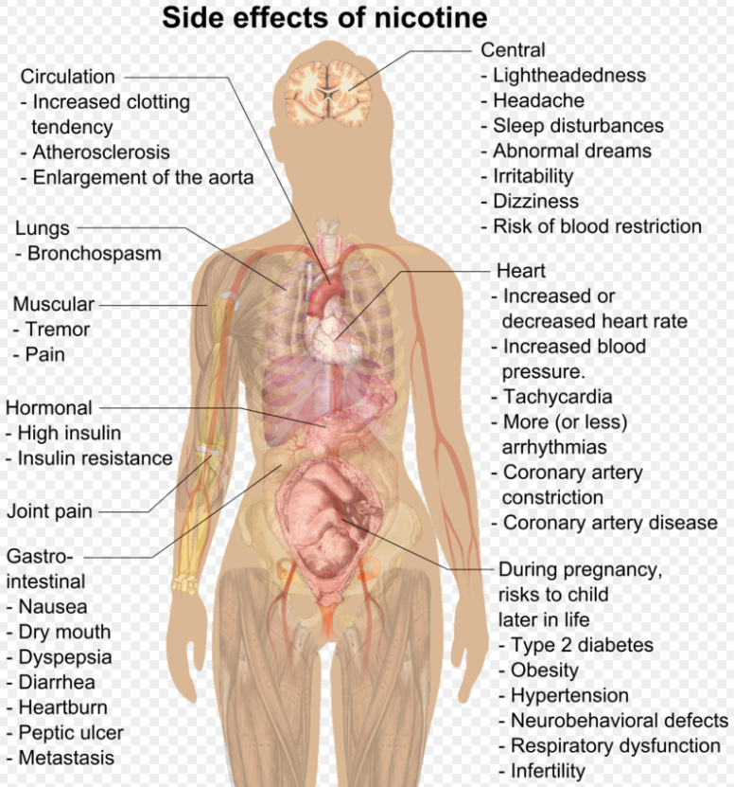
Nicotine
Why is it so difficult to quit smoking? The answer is in the brain: “the need” comes from chemical cerebral processes.
NICOTINE
Nicotine was discovered in 1809 in France, by Louis Nicholas Vanquelin and is a strong and violent stimulant of the neurovegetative system.
50g of nicotine (the content of 4 cigarettes) can kill a person within minutes
Nicotine is quickly absorbed in the bloodstream, and it reaches the heart through, large blood vessels and ultimately the brain
The body gets used to nicotine very quickly, because it is a psychoactive substance that increases energy and concentration power.
The active properties of nicotine act primarily on the reward and memory systems

Slide 18
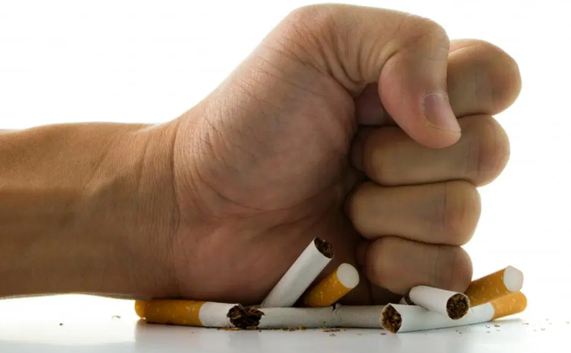
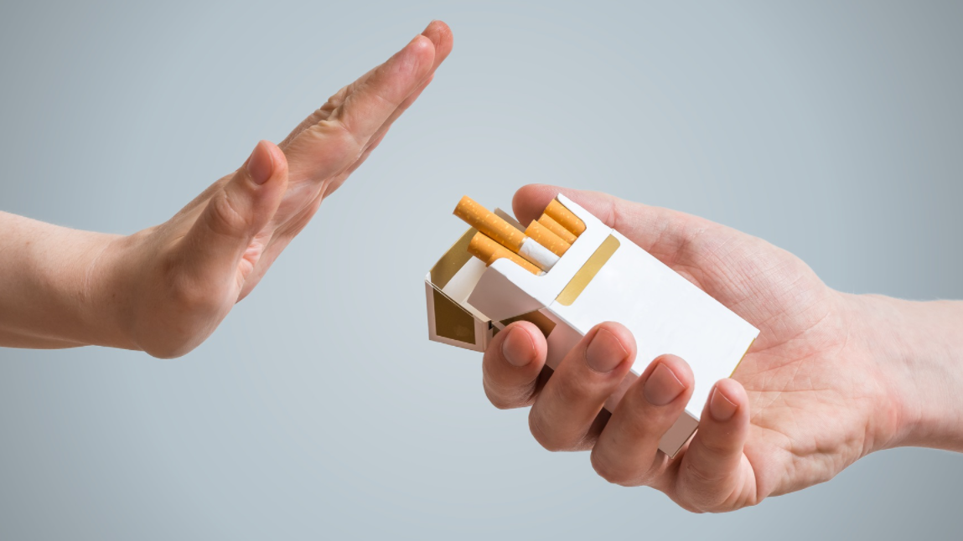
Quitting
Each person has the right to choose freely whether they want to smoke. The important thing is to be conscious that our choices we make can negatively impact our life, but also the lives of the people surrounding us..
POSITIVE EFFECTS QUITTING
STEP 1: PREPARE TO QUIT
Be aware of when and why you smoke
Reduce the number of cigarettes
Avoid smoking places and try to hand out more with non-smokers
Set a fixed date for quitting
Quitting reduces the risk of sickness and susceptibility to infections
1
Hair, clothes and breath will not be negatively affected by the tobacco smell
STEP 2: QUIT
Throw your cigarettes away
Keep yourself busy with other activities
If you feel the need to smoke, chew gum ☺
Teeth and fingers will regain their natural color
2
Quitting increase the level of physical fitness and improves immunity
STEP 3: RESIST THE TEMPTATION
Irritability and sleepiness are part of the process
Focus on the advantages of quitting: improved health, higher savings
To motivate yourself, keep track of the time passed since quitting
If you have a transgression, do not get discouraged, quitting is a long process
Quitting saves money
3
Quitting lengthens the life span

Slide 19
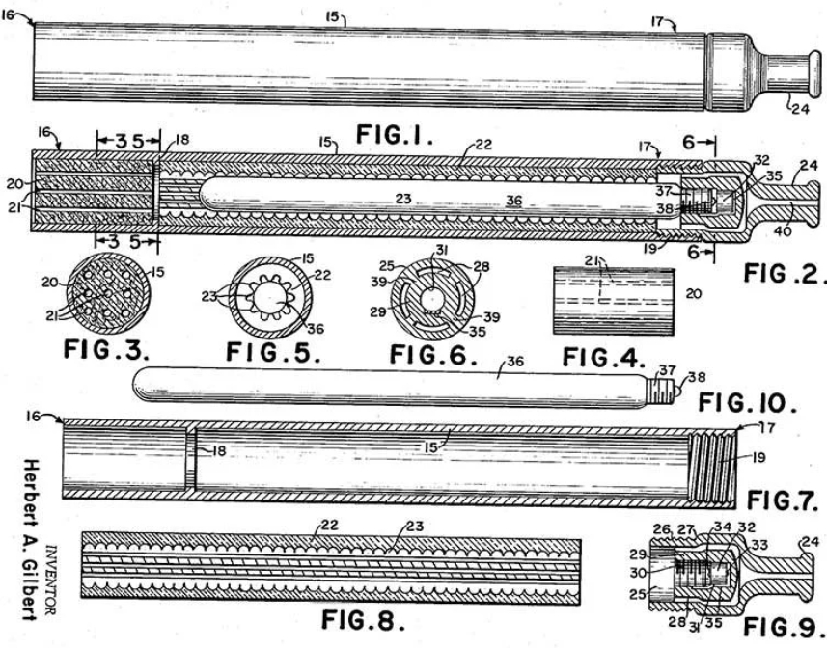
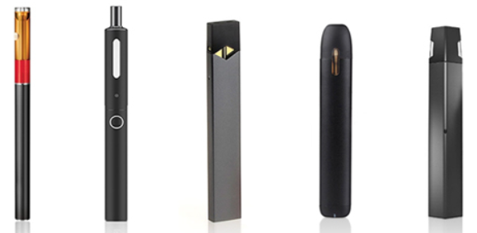
Electronic cigarette
The electronic cigarette seems like a recent innovation in the field of smoking. Here is a brief history for the e-cigarette.
1963
The first recorded instance of an individual having designed an e-cigarette device was a gentleman called Herbert A Gilbert. Back in 1963 Gilbert filed a patent on his electronic cigarette design however unfortunately the idea didn’t take off.
2003
After his father tragically died of lung cancer, a Chinese pharmacist by the name of Han Lik’s - a smoker himself, invented the electronic cigarette.
2003-2007
Initially enjoyed primarily in China, the success of Lik’s e-cigarette soon spread to numerous countries within Europe and in 2007 was adopted by the American market.
2009
In 2009 both Canada and Australia banned electronic cigarettes. The FDA (USA) also stopped electronic cigarettes from being imported
2019
A UK clinical trial found that when combined with expert face-to-face support, people who used e-cigarettes to quit smoking were twice as likely to succeed as people who used other nicotine replacement products, such as patches or gum.

Slide 20
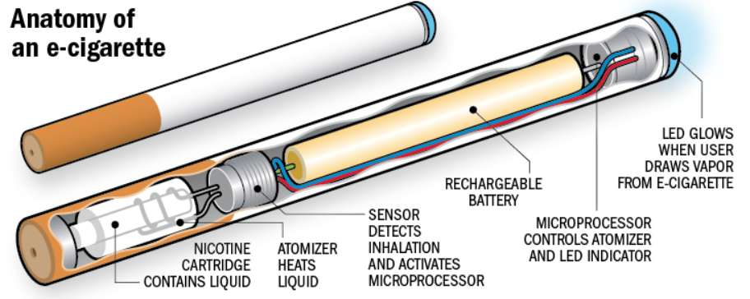
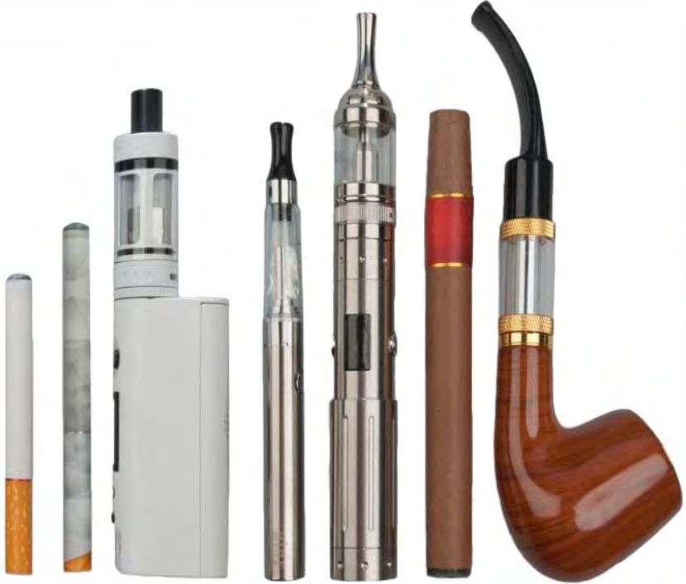
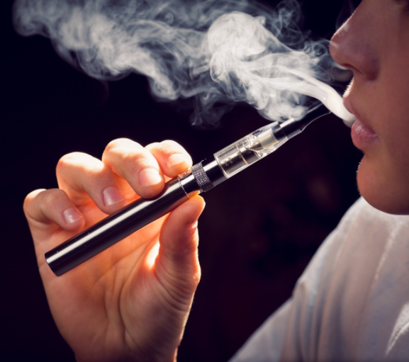
Description and types of e-cigarettes
An e-cigarette is made up of several components, as shown in the representation below.
There are a variety of models available:
Cigalikes look like tobacco cigarettes and can be disposable or rechargeable.
Vape pens are shaped like a pen or small tube, with a tank to store e-liquid, replaceable coils and rechargeable batteries.
Pod systems are compact rechargeable devices, often shaped like a USB stick or a pebble, with e-liquid capsules.
Mods come in different shapes and sizes but are generally the largest e-cigarette devices. They have a refillable tank, longer lasting rechargeable batteries, and variable power.

Slide 21
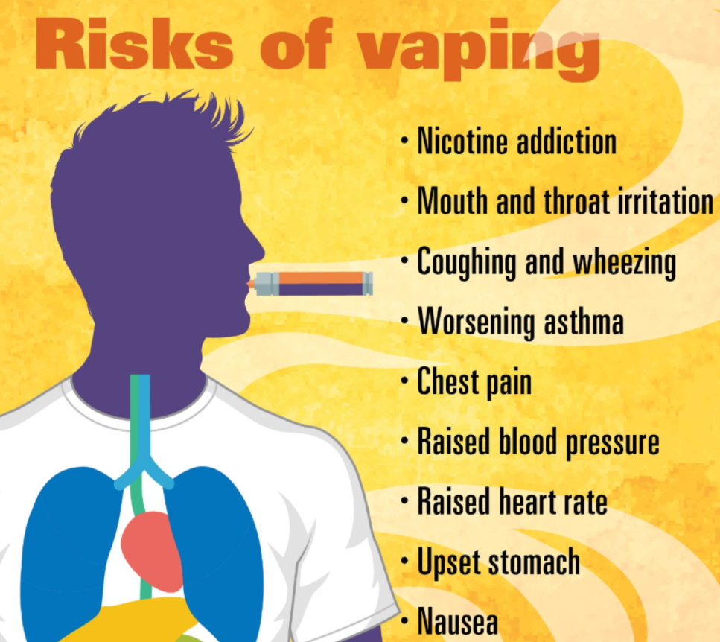
Pros, cons and dangers of vaping
E-cigarettes are quite controversial. Whilst some studies show they are much better than regular cigarettes and other tobacco products, some say they can cause a great deal of health issues.
PROs
CONs
E-cigarettes contain nicotine but not cancer-causing tobacco.
Passively breathing vapor from e-cigarettes is unlikely to be harmful
Study evidence shows that e-cigarettes are helping people stop smoking
Vaping causes addiction, just like cigarettes
Vaping can cause a series of serious health issues (see below)
Vaping is on the rise among youngsters: 1/5 school kids are vaping in the US (2018 study)
The dangers of vaping
Irreversible brain damage – part of the brain responsible for decision making and impulse control is not fully developed until age 25. Teens and young adults are at risk of long-lasting effects, including mood disorders and permanent lowering of impulse control.
Toxic chemicals and metals – E-cigarette aerosol contains toxic chemical metals.
Causes attention and learning problems – Nicotine changes the way in which synapses are formed, which harms the part of brain that controls attention and learning.
Weakens immune system – Vaping weakens the immune system, increasing susceptibility to all kinds of illness and infections.
Gateway to smoking – youngsters who vape are 4 times more likely to start smoking, according to a study made in the US.
Blood vessel damage – Vape that contains nicotine increases the blood pressure and can cause the heart to swollen and arteries to stiffen up.

Slide 22
Statistics for Romania – GATS 1/2
Several studies are conducted at global, European and national level about smoking. Two of these studies, GATS (Global Adult Tobacco Survey) and GYTS (Global Youth Tobacco Survey) are using a global standardized methodology with the goal of making the results comparable. Some indicators produced in the most recent GATS study from 2018 are analyzed below.
Tobacco consumption
Quitting smoking
Sample size: 5.63 M adults
23.8% of the smokers attempted to quit smoking in the last 12 months
30.2% smoke tobacco on a regular basis
57.1% of the smokers that saw a doctor in the last 12 months were advised to quit smoking
14
21.2%
75.1% of smoker smoke within the first 30 min of waking up
17.9% of smokers planned or thought of quitting smoking in the next 12 months

Slide 23
Statistics for Romania – GATS 2/2
Several studies are conducted at global, European and national level about smoking. Two of these studies, GATS (Global Adult Tobacco Survey) and GYTS (Global Youth Tobacco Survey) are using a global standardized methodology with the goal of making the results comparable. Some indicators produced in the most recent GATS study from 2018 are analyzed below.
Passive smoking
21.9% of adults were exposed to cigarette smoke in their home
Attitudes and perceptions
90.6% of adults acknowledge that smoking can produce severe diseases
10.1% of adults working indoors were exposed to cigarette smoke at work
Media
55.8% of adults acknowledged anti-smoking messages on radio or TV
86% of adults are aware that passive smoking can cause severe affections for the non-smokers
7.5% of adults were exposed to cigarette smoke in restaurants
92.6% of adults agree that smoking in the car, in the presence of children should be forbidden
28.9% of adults noticed marketing for cigarettes in shops
27.5% of adults were exposed to smoke in bars and clubs

Slide 24
Did you know?
To end this on a fun note, here are some interesting facts about smoking and cigarettes:
Taste of the cigarette
Urea – a chemical compound found in urine is used for flavoring the cigarettes and other tobacco products.
Substances added
Sugar and cocoa are common substances added to the cigarettes.
Approximately 20% of a cigarette content consists of sugar.
Hydrocarbon
A lit cigarette produces hydrocarbon 7 times faster than the exhaustion gas of a car.
Light cigarettes
Light cigarettes are produces by combining tobacco with CO2 and heated until the tobacco increases its volume in a similar way as expanded foam.
Expanded tobacco is then placed in the same paper as regular cigarettes.
Flavored cigarettes
Different types of topping are mixed in tobacco for adding flavor and taste to the cigarettes. These toppings include cloves, liquorice, orange oil, apricot seeds, lavender, cacao, carrot oil, vanilla, rum, etc.

Slide 25
Thank you!

